Slide 1
Turbomachinery: Full component matching

Slide 2
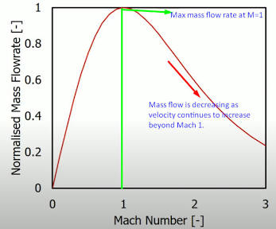
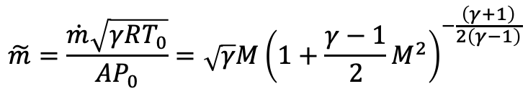
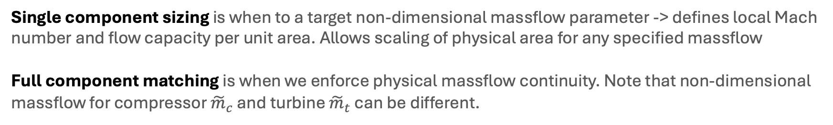
Component matching
Single component sizing is when to a target non-dimensional massflow parameter -> defines local Mach number and flow capacity per unit area. Allows scaling of physical area for any specified massflow
Full component matching is when we enforce physical massflow continuity. Note that non-dimensional massflow for compressor ${\tilde{m}}_{c}$ and turbine ${\tilde{m}}_{t}$ can be different.
Choke limit (max massflow)
Massflow Parameter: dictates how much flow a given geometric area can physically handle.
$$\tilde{m}=\frac{\dot{m}\sqrt{γRT_{0}}}{AP_{0}}=\sqrt{γ}M{\left(1+\frac{γ−1}{2}M^{2}\right)}^{−\frac{\left(γ+1\right)}{2\left(γ−1\right)}}$$

Slide 3
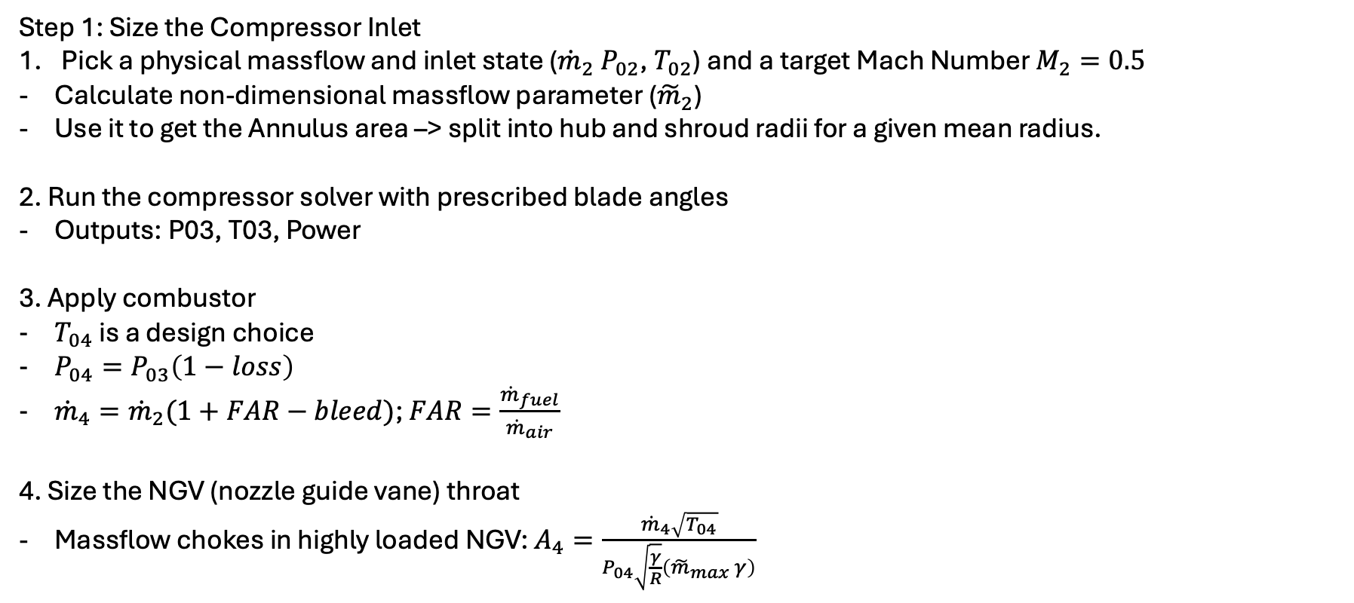
Integrating MFP with Turbo design
Step 1: Size the Compressor Inlet
Pick a physical massflow and inlet state (${\dot{m}}_{2}$ $P_{02}$, $T_{02}$) and a target Mach Number $M_{2}=0.5$
Calculate non-dimensional massflow parameter (${\tilde{m}}_{2}$)
Use it to get the Annulus area –> split into hub and shroud radii for a given mean radius.
2. Run the compressor solver with prescribed blade angles
Outputs: P03, T03, Power
3. Apply combustor
$T_{04}$ is a design choice
$P_{04}=P_{03}\left(1−loss\right)$
${\dot{m}}_{4}={\dot{m}}_{2}(1+FAR−bleed)$; $FAR=\frac{{\dot{m}}_{fuel}}{{\dot{m}}_{air}}$
4. Size the NGV (nozzle guide vane) throat
Massflow chokes in highly loaded NGV: $A_{4}=\frac{{\dot{m}}_{4}\sqrt{T_{04}}}{P_{04}\sqrt{\frac{γ}{R}}\left({\tilde{m}}_{max} γ\right)}$
Choked value of massflow

Slide 4
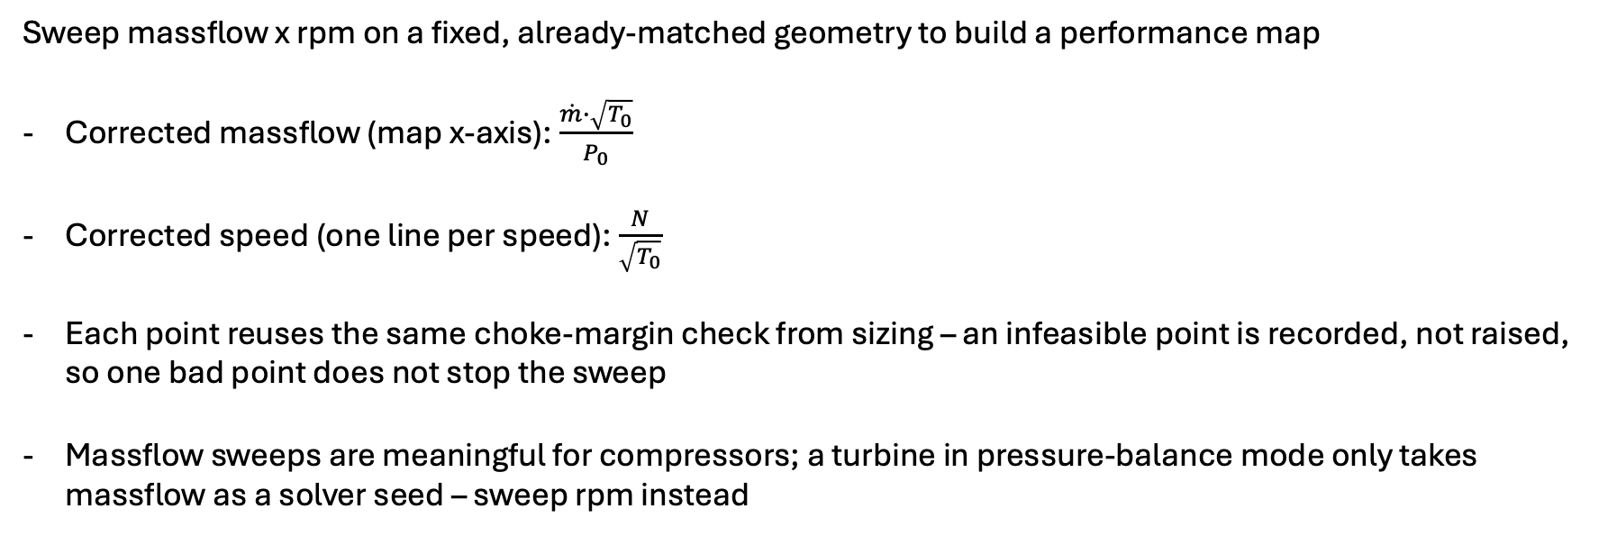
Sweeping the Operating Map
Sweep massflow x rpm on a fixed, already-matched geometry to build a performance map
Corrected massflow (map x-axis): $\frac{\dot{m}∙\sqrt{T_{0}}}{P_{0}}$
Corrected speed (one line per speed): $\frac{N}{\sqrt{T_{0}}}$
Each point reuses the same choke-margin check from sizing – an infeasible point is recorded, not raised, so one bad point does not stop the sweep
Massflow sweeps are meaningful for compressors; a turbine in pressure-balance mode only takes massflow as a solver seed – sweep rpm instead

